Slide 1
Presentation by
Exchange Studies at the University of the West of England
UWE Study Abroad Team
Notes:
Welcome to this short presentation about exchange studies at UWE Bristol during the 2021-22 academic year

Slide 2


Notes:
UWE Bristol is on of the UK’s most popular Universities, with over 27,000 students
Our outstanding learning is backed by world-class research that’s makes a real difference

Slide 3

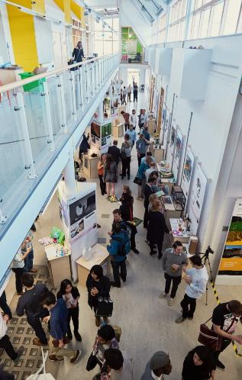

An exchange destination like no other
"From an academic perspective, UWE Bristol is one of the best universities I had a chance to study at. I had a great experience and the campus environment is really friendly. I enjoyed my courses and the teaching style."
Snizhana, from Poland; studied Politics and International Relations
Notes:
Our focus in real world experience , learning experiences mean you’ll be adaptable, enterprising and ready for work.
We consistently receive positive feedback from students from our exchange partner institutions who study with us for either a semester or full year exchange

Slide 4

Unbeatable Bristol

Slide 5

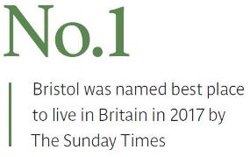
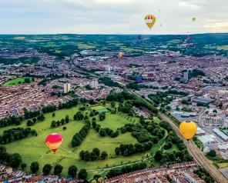
Bristol – the best city to live in the UK
Strongest economic performer outside
of London
(Centre for Cities 2015)
Just 90 minutes from London
Notes:
The largest city in the South West of England with population of 450,000
Just 90 minutes from London
The most ‘googled’ city outside of London.
Bristol is well-connected to the rest of UK, Europe and beyond
Bristol is a vibrant and creative city
It is a brilliant, diverse and multi-cultural city surrounded by beautiful English countryside. The city is famed for its original music, festivals, street art, food and culture
You won’t be bored. There are plenty of shops, restaurants, museums, theaters and parks to keep you entertained
The living costs in Bristol are estimated to be £200-£290 per week.

Slide 6
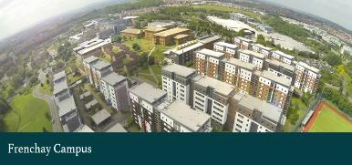
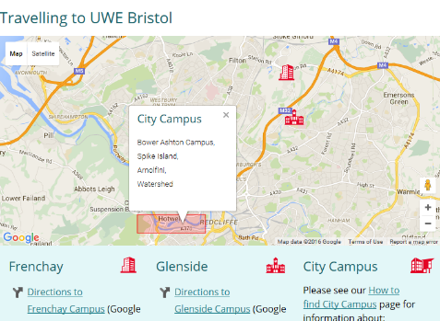
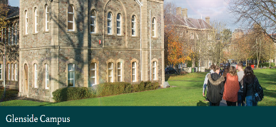

Campuses
Virtual campus tours:
  Frenchay
  City Centre
  Glenside
Notes:
UWE Bristol is based on 3 campuses:
Frenchay campus – UWE Bristol’s Main campus – is home to our Faculty of Business and Law which welcomes exchange students to study subjects including Business, Economics, Accounting, Marketing, and Law). The Faculty of Environment and Technology is also based here – and hosts exchange students in the subject areas of (Architecture, Computer Science and Geography and Planning) are located here. Some Departments for Health and Applied Sciences are here too (Politics and International Relations, Sociology, Criminology, Psychology, Biomedical Science, Philosophy.
Frenchay campus is also home to the world-renowned Bristol Robotics Laboratory; our large Exhibition and Conference Centre; the Centre for Performing Arts; and the majority of our sports facilities are on campus or nearby.
City Campus – City Campus and Bower Ashton Campus is home for UWE Bristol’s Art and Design (Graphic design, Illustration, Interior Design, Fashion, Fine art) and Film and Journalism School ( Animation, Photography, Filmmaking)
Glenside Campus – Glenside is home to UWE Bristol’s Faculty of Health and Applied Sciences. Our Allied Health Professions (Physiotherapy, Paramedic Science) as well as Nursing and Midwifery courses are taught here.

Slide 7
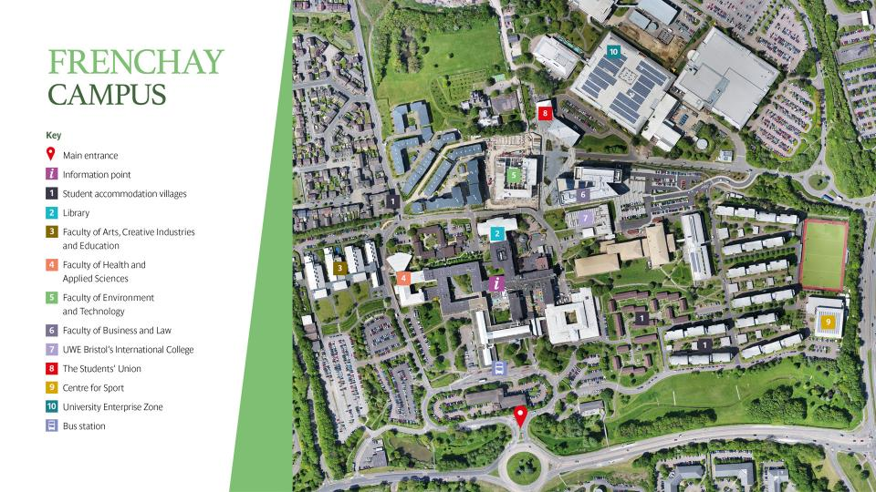
Notes:
Here’s an aerial view of Frenchay campus to give you an idea of it’s size. As you can see it’s a very green campus.

Slide 8
Faculties
Arts, Creative Industries and Education (ACE)
Business and Law
(FBL)
Environment and Technology (FET)
Health and Applied Sciences
(HAS)
Notes:
The University is organised into 4 faculties, which each have around 4 departments within them.

Slide 9
Rankings, Outcomes & Student Satisfaction
UWE is ranked 28 in the Guardian University Guide League Table 2020
Course specific rankings from the Guardian University League Table 2020:
6 in Architecture
3 in Film Production and Photography
21 in Art
22 in Geography and Environmental Science
Graduate Outcomes – 2018 DLHE Survey:
94% of UWE Bristol International first-degree graduates are in employment or further study six months after graduation
Ranked 7th in England for student satisfaction in the 2019 National Student Survey
Notes:
Out of over 120 institutions
We perform particularly well in fields such as…
Our graduates have good outcomes, with over 94% of students in employment of further study 6 months after graduation
We are also highly ranked for student satisfaction – measuring areas including quality of courses, teaching, provision of facilities, advice and support services

Slide 10
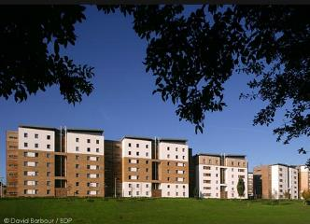
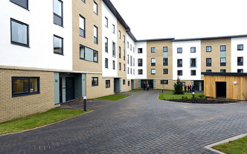
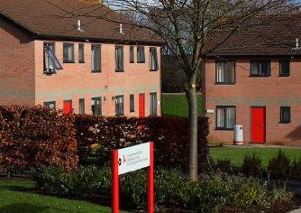
Accommodation – Frenchay
On campus: Student Village, Wallscourt Park, Carroll Court
2400+ rooms
Prices ranging from £4694 for a twin room to £7700 for a studio flat
Most on campus accommodation provides a reception, extensive CCTV monitoring and on-site staff, shared facilities including a kitchen and lounge, and shared or ensuite bathrooms
In easy reach of transport links, campus facilities including sports facilities and the Students Union bar & shops, and local supermarkets
Notes:
Exchange students can consider on-campus or city centre accommodation provided by UWE and our partners, or private accommodation.
Our accommodation on Frenchay campus is across SV, Wallscourt Park and Carroll court.
Prices range from 4600 to 7700 for a year long contract – a limited number of semester-only accommodation is also available

Slide 11
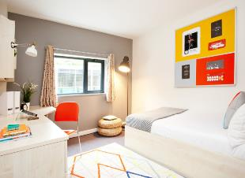
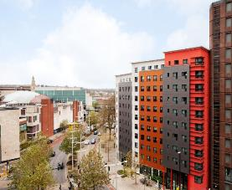
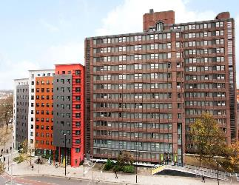
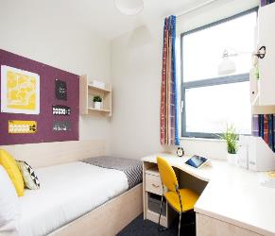
Accommodation – City Centre
Phoenix Court
92 single study bedrooms
£6864 (standard en-suite)
Bike storage
Common room & pool table
Marketgate
490 rooms, including 49 en-suite and 17 studios
£6512.00 (en-suite rooms)
Communal living areas with flat screen TV’s
Notes:
Accommodation options in the city centre include Phoenix Court and Market gate

Slide 12
Exchange Studies at UWE Bristol
UWE Bristol is an international university, with an excellent reputation for teaching and learning. Coming to study at UWE Bristol for a semester or a full academic year from a partner institution is a great opportunity to join a welcoming and supportive University.
We have exchange agreements with over 80 partner institutions. We welcome students from all over the world to study subjects across all 4 faculties, in subject areas such as:
    Business Management, Accounting and Finance
    Architecture – including Interior Architecture, Planning and Environmental Engineering
    Geography and Environmental Management
    Nursing
    Allied Health Professions – Including Physiotherapy, Diagnostic Imaging
    Health and Social Sciences – Including Sociology, Philosophy, Psychology and Politics and International Relations
Exchange Agreements are usually limited to specific subject areas or academic departments – and cross-faculty study is usually not permitted due to both timetabling constraints and agreement limitations.
A full list of our existing exchange partners is available on our webpages.

Slide 13
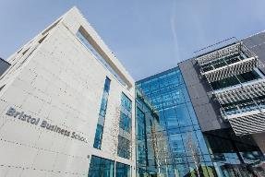

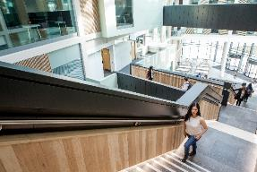
Business and Management
Leadership, collaboration, enterprise. Our business and management courses enable students to develop the skills they need for a successful career in business by learning in an authentic environment, with access to state-of-the-art learning tools.
Shortlisted for Business School of the Year in the Times Higher Education Awards (2017), Bristol Business School offers courses that hold accreditation from many UK and international professional and educational bodies, including ACCA, CIMA, CIPD and EFMD (EPAS).
Located in a new £55m landmark Business School at the heart of Frenchay campus, students benefit from wall-to-wall world class facilities, modern lecture theatres, a Bloomberg trading room and Atrium café.
The department welcomes students from among it’s 25 exchange partners each semester and provides a bespoke induction process to maximize student experience and integration.
Incoming exchange students have the opportunity to study modules in Business and Management, International Business, Marketing, Accounting and Finance, Economics and Human Resource Management.
Students can study with us for either a semester or a full academic year, and are permitted to switch programmes following the successful completion of their first semester.
Notes:
Our Business courses are hold international accreditations – including ACCA, CIMA, CIPD and EFMD.
Our landmark Business school building, which opened in 2017, is at the heart of Frenchay campus and is home to modern lecture theatres, a Bloomberg trading room, and the Atrium Café.
We welcome students from among our 25 exchange partners each semester with a bespoke induction process to maximise student experience and integration.
Students can choose to study modules in Business and Management, International Business, Marketing, Accounting and Finance, Economics and Human Resource Management.
Students who study with us for a full year are permitted to switch programmes following the successful completion of their first semester.

Slide 14



Geography
UWE’s BSc Geography course is accredited by the Institution of Environmental Sciences and the Royal Geographical Society.
Exchange students usually join either level 2 or level 3 of the course (year 2 or year 3 of the 3-year course).
The course equips students with a solid understanding of the science behind the main environmental challenges faced by human society. Students learn about managing natural environments, and develop skills in surveying, mapping, environmental assessment, geographical statistics and computer-based spatial analysis. Optional modules include climate change, river dynamics, ecosystem conservation and global resource management.
Our well equipped laboratories and field trips provide real-world experience and opportunities to develop vital professional skills.
Our BSc Geography course has achieved >=97% overall student satisfaction for four years in a row in the UK’s National Student Survey.
Notes:
Our BSc Geography course is accredited by the Institution of Environmental Sciences and the Royal Geological Society.
Students learn about managing natural environments, and develop skills in surveying, mapping, environmental assessment, geographical statistics and computer-based spatial analysis. Optional modules include climate change, river dynamics, ecosystem conservation and global resource management.
Our well equipped labs and field trips provide real world experience and the opportunity to develop vital skills. The BSc Geography course regularly achieves over 97% student satisfaction in the UK’s National Student Survey.

Slide 15
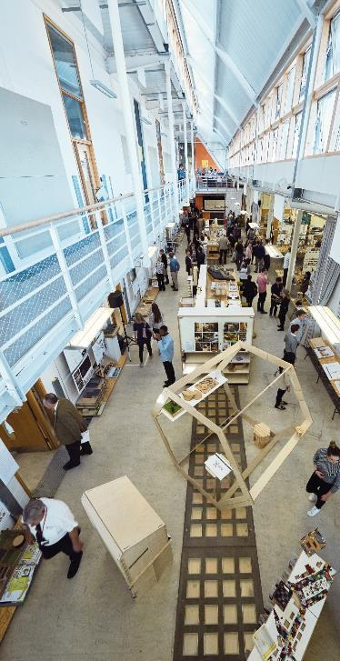



Architecture & Planning
Interior Architecture
The Department of Architecture & The Built Environment offers incoming exchanges for students studying architecture or interior architecture. All students are enrolled into a Design Studio as the core of their study and can then choose from a wide range of other modules.
Module options include: design, technology, history, urbanism, interiors and theory. You can also opt to take a work placement.
UWE’s Architecture and Planning course is ranked 1st nationally for student satisfaction (100%) and produces sought-after graduates with specialist knowledge and the skill to create exciting buildings and places. The course has a number of well established exchange partnerships and UWE recognises the diversity and new approaches to learning that these students bring to studio and group work.
Staff include a wide range of very experienced academics and professionals and there is a lively list of weekly guest presentations. Students can join the Architecture Society and take part in a wide range of social events.
Students are based in ‘The Studios’ - winner of the 2004 Royal Fine Art Commission ‘Building of the Year’ for Architectural Education.

Slide 16
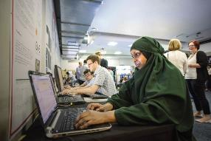

Social Sciences
Our social science courses give students the knowledge, confidence and motivation to make a real difference to society and the community. Students develop skills which allow them to question, critique and evaluate the world around them.
Courses in the department include Politics and International Relations; Psychology; Sociology and Criminology and Philosophy.
94% of graduates from the department are in work six months after graduation (HESA Survey, 2017).
Our Politics and International Relations students reported a 93% student satisfaction rate in the latest National Student Survey (2017). The programme welcomes students from exchange partners from around the world.
Our Psychology programme is accredited by the British Psychological Society and welcomes exchange students from Italy and the Netherlands.
Our Criminology and Sociology programmes have strong links with local police, council and criminal justice organisations and services.

Slide 17

Allied Health Professions
You’ll get the knowledge and skills you need to make your mark as an Allied Health Professional. Working with colleagues across disciplines, you’ll build confidence and go into practice with partners across a variety of setting in the health care sector.
Our Physiotherapy programme is accredited by HCPC and the Chartered Society of Physiotherapists and has excellent links with leading healthcare providers across the South West, including the NHS, and private and voluntary sector organisations. The programme has exchange partner institutions in Finland and Norway.
Notes:
Students from Allied Health professions will join a programme accredited by the HCPC and the CSPs. The programme, based at our Glenside Campus, has excellent links with leading healthcare providers across the SW. Incoming exchange students will work closely with these partner organisations whilst undertaking clinical placements.

Slide 18

Allied Health Professions
Our Diagnostic Imaging programme gives students access to industry-standard technology and provides work placements in NHS and private healthcare settings. Accredited by HCPC and the College of Radiographers, the course sends and receives exchange students from the Arctic University of Norway in Tromso.
Our Occupational Therapy programme has a strong practical focus, close links with employers and is namaged by an experienced academic team. Accredited by HCPC and the Royal College of Occupational Therapists, the course sends and receives exchange students from the Arctic University of Norway in Tromso.

Slide 19
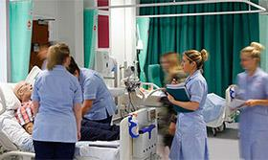
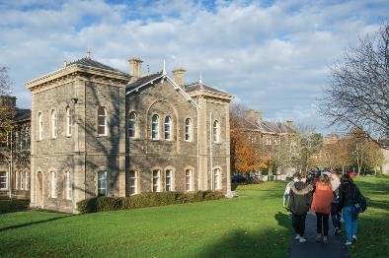
Nursing and Midwifery
UWE’s Department of Nursing and Midwifery has strong links with external agencies including 14 NHS trusts and Primary Care Trusts and voluntary agencies. Academic staff collaborate with partners across the health and social care sectors in research, practice development and education initiatives. The department provides a friendly and supportive environment for staff and students.
Our Midwifery programme and all of our Nursing programmes (Adult, Child, Mental Health and Learning Disability Nursing) and are accredited by the Nursing and Midwifery Council (NMC). The Department has a long history of sending and receiving exchange students from institutions in Norway, Finland and Spain.
A Nursing or Midwifery exchange student’s stay at UWE can typically include:
1 week University/Placement induction
2x 5-6 week placements with local healthcare providers – for example: intensive care, accident and emergency, or with community nursing teams
Notes:
Incoming exchange students to our department of Nursing and Midwifery will also be able to benefit from UWE’s close links with external agencies, including 14 NHS trusts, primary care trusts and voluntary agencies.
Our nursing programmes – which include Adult, Child, MH and LD nursing are accredited by the NMC. We have a long history of sending and receiving exchange students from institutions in Norway, Finland and Spain.
An exchange students stay will typically include a weeks’ induction on campus, followed by 2 5 or 6 week long placements with local healthcare providers – for example in intensive care, accident and emergency, or with community nursing teams.

Slide 20
Support for Exchange Students
UWE Bristol is an international university, with a worldwide reputation for excellence in teaching and research. Coming to UWE Bristol for a semester or a year is a great opportunity to study in a welcoming and supportive environment. Exchange students are supported by the Study Abroad team and an academic colleague before and during their stay with us.
Gain credits during your studies
UWE Bristol awards credit to exchange students after required examinations have been taken and/or coursework has been completed. This credit is recognized by your home University as contributing towards your degree.
Application Process
To submit an application for an exchange place at UWE Bristol, you must first have applied, been selected and been nominated by your home institution. Once UWE Bristol has received your formal nomination, you will be contacted by e-mail and invited to submit your application through our online system
Application Deadlines:
31 March for Semester 1 and full-year study commencing in September
31 October for Semester 2 commencing in January
Funding your exchange with UWE Bristol
Students selected and nominated as exchange students do not pay any tuition fees to UWE. Incoming student may receive funding from their home University, but are not eligible for further support from UWE Bristol.
Notes:
Exchange students are supported by the Study Abroad team and an academic colleague before and during their stay with us.
We award credit to exchange students following assessments – this is usually recognised by students’ home universities as contributing towards your degree
We have a simple application process – following nomination by your home institution, you’ll be asked to submit an application through our online system. Our application ddeadline for students joining us in September 2021 is 31 March. For students joining us in January 2022, you must apply by 31 October.
Incoming exchange students are not required to pay any fees to UWE Bristol. Students may be eligible for funding from their home university, but are not eligible for further support from UWE Bristol.

Slide 21
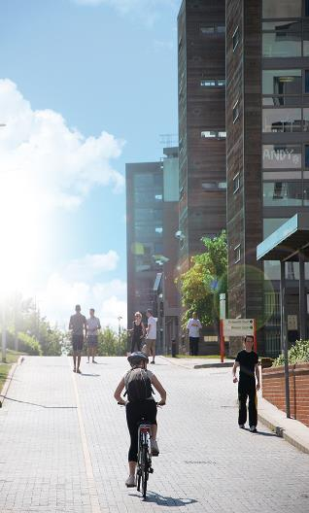
Practical Information
Term Dates
Semester 1
  Welcome Week typically takes place mid-September
  The teaching term starts in late September, ending in early December.
  Assessment period: Early January
Semester 2
Welcome Week typically takes place early January
The teaching term starts in mid-January, ending in late April.
Student vacation over Easter lasts 2 weeks
Assessment period: Early May

Slide 22
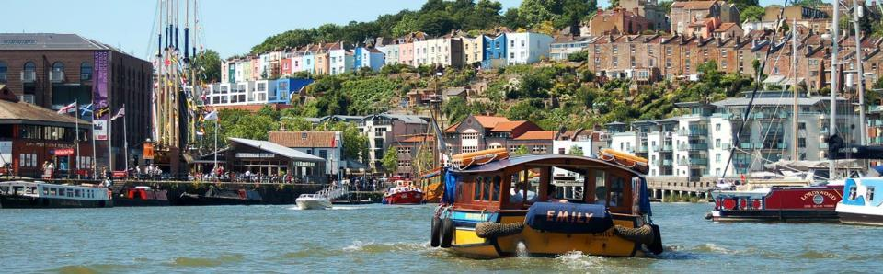
Practical Information
Airport Welcome
UWE offers a free welcome service to new EU and International students from London Heathrow airport on specific dates in September and January
Orientation and Induction
New exchange students can attend UWE’s International Student Orientation sessions prior to the start of term, and will receive a full academic induction from their department.
The Study Abroad team organize a welcome event for new exchange students. Further social activities for exchange students are offered by the UWESU Exchange Student Society.

Slide 23
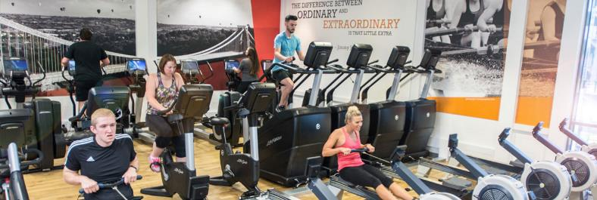
Student Life and Facilities
UWE’s Student Union (UWESU) provides students with social and professional opportunities, builds community and represents students during their time at UWE Bristol. Across all campuses, the SU bars and cafes organize regular quiz nights, film screenings, open mic nights, as well as one-off events. The Student Union Advice Centre offers academic advice and support with finding part-time work or accommodation. They also coordinate local and international student volunteering opportunities, and support student-led sport, faith, identity, political, charity and special interest societies. Find out more
UWE’s Centre for Sport, based on Frenchay Campus, is a 5.5m state-of-the-art sports development featuring fitness suites, an astro pitch, a sports hall, a climbing wall and squash courts, and outdoor trim trail. Memberships start at £125 for the full year. Semester-only membership is also available exclusively for exchange students staying for less than a year.

Slide 24

Support every step of the way
The Study Abroad team work closely with students’ home institutions and academic departments to ensure the smooth running of study exchanges and are happy to answer queries from incoming exchange students. The team should be the first contact point for all queries: studyabroad@uwe.ac.uk
UWE’s Global Student Support team coordinate International Student Orientation, which helps international students meet people, have fun and to get to know UWE, Bristol and each other!
Our Student advisors can provide students with information on a wide range of University matters, including module choices, academic regulations and extenuating circumstances. Students can also discuss academic issues with their departmental exchange coordinators or with their module leaders.
Global PALs (existing UWE students) offer support and guidance and will help you find your way around Bristol and the campus as well as providing information about UWE’s services and facilities.
We have dedicated staff who can give guidance on managing money as well as Visas, Immigration and the UK’s PBS (Points based system).
Our Wellbeing Service provides support for students experiencing personal issues. Our Faith and Spirituality service provides facilities and information for prayer, worship, meditation and reflection, opportunities to meet others and advice on spiritual and ethical concerns.
Notes:
We offer a wide range of support for students. The Study Abroad team are the first contact point for all queries and can offer signposting to other support services at UWE.

Slide 25

Student Feedback
UWE examined the feedback from students who studied here through the European-wide Erasmus exchange programme in 2016-17 and found:
94% of students were ‘satisfied’ or ‘very satisfied’ with their experience overall
88% were ‘satisfied’ or ‘very satisfied’ with the administrative support and 84% with the academic mentoring.
77% were ‘satisfied’ or ‘very satisfied’ with course content offered by UWE.
“I loved my Erasmus experience. It was one of the best experience in my whole life: I have the feeling so many things have changed in me and I feel way more confident and less scared than before. I also learned…to have other ideas about my future. I have two homes - one in France and one in England. I have two families and even if leaving is the hardest thing ever it was worth it!”

Slide 26
Covid-secure Campus
We are following UK government guidance to reduce the spread of Coronavirus:
Hands Wash hands frequently, and make use of sanitising gel stations across campus
Face As of November 2020, students are required to wear a face covering inside all campus buildings unless medically exempt. Face coverings must also be worn at all times in shops, catering outlets and on public transport
Space We ask students to stay 2m away from people outside their household
Support
Our dedicated Covid Support team are ready to students manage self-isolation, providing help with test booking, and checking in with students during any self-isolation period.
Updates
https://www.uwe.ac.uk/news/coronavirus
https://www.gov.uk/coronavirus

Slide 27


Any questions?
Studyabroad@uwe.ac.uk
iStock.com/LuminaStock
Notes:
If any queries please email us
We looking forward to welcoming you

