Slide 1
Presentation
Call for Applications PhD Programme 2023-2024
Department of Economics and Management, University of Padova
Thursday, 4 May 2023

Slide 2
Agenda
1. Welcome Enrico Rettore (Head of the PhD Programme)
2. Overview Michele Fabrizi (Deputy-Head, Management)
3. Management Curriculum Eleonora Di Maria (PhD - Executive Committee)
4. Economics Curriculum Enrico Rettore (Head of the PhD Programme)
5. Alumnae Stories Michela Carraro/Isha Gupta
6. Q&A

Slide 3
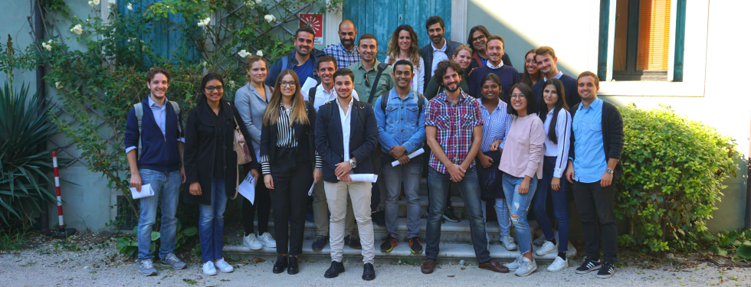
Welcome
Prof. Enrico Rettore
Head of the PhD Programme

Slide 4
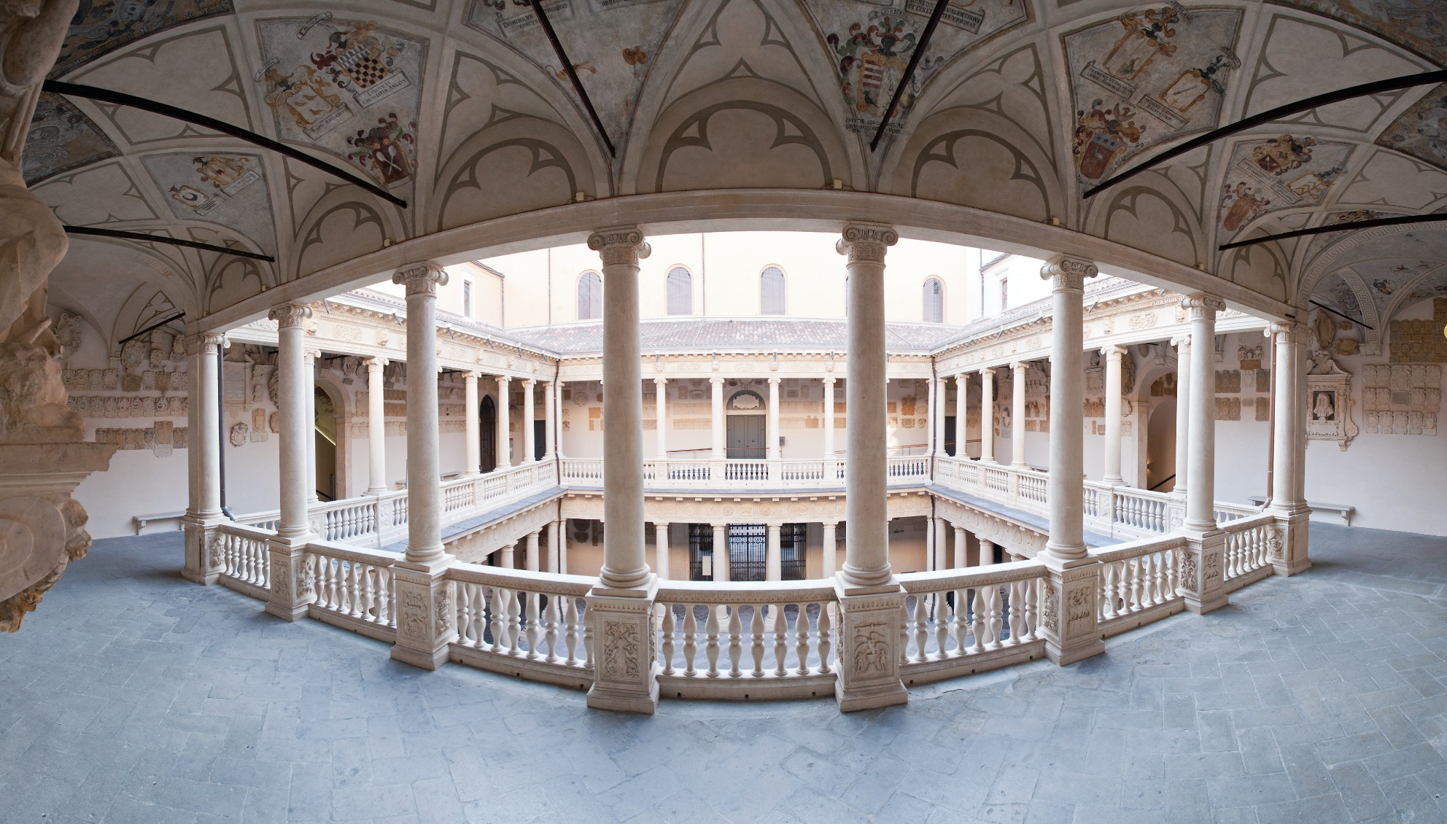
Why Padova?
Founded in 1222, the University of Padova is one of Europe’s oldest and most prestigious multidisciplinary universities

Slide 5
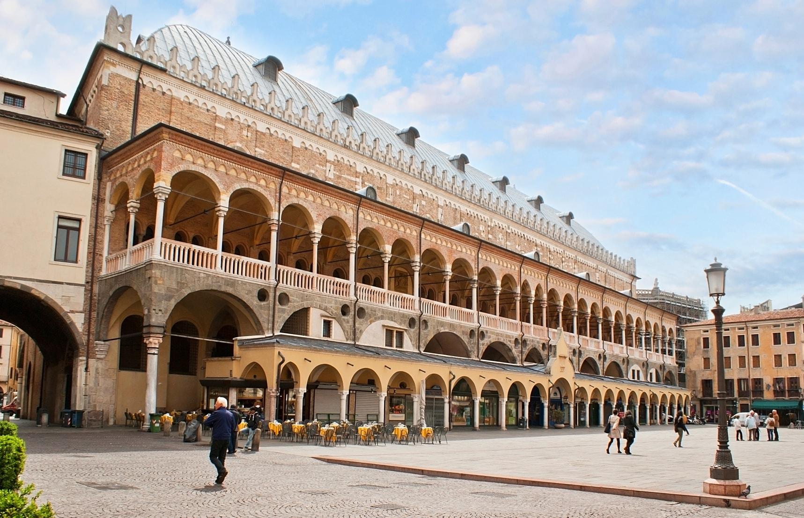
Why Padova?
60,000 students, 1,300 PhD candidates,
2,200 academic staff & researchers
Lively, dynamic, and international environment in the heart of North Italy

Slide 6
PADOVA, ITALY

Slide 7
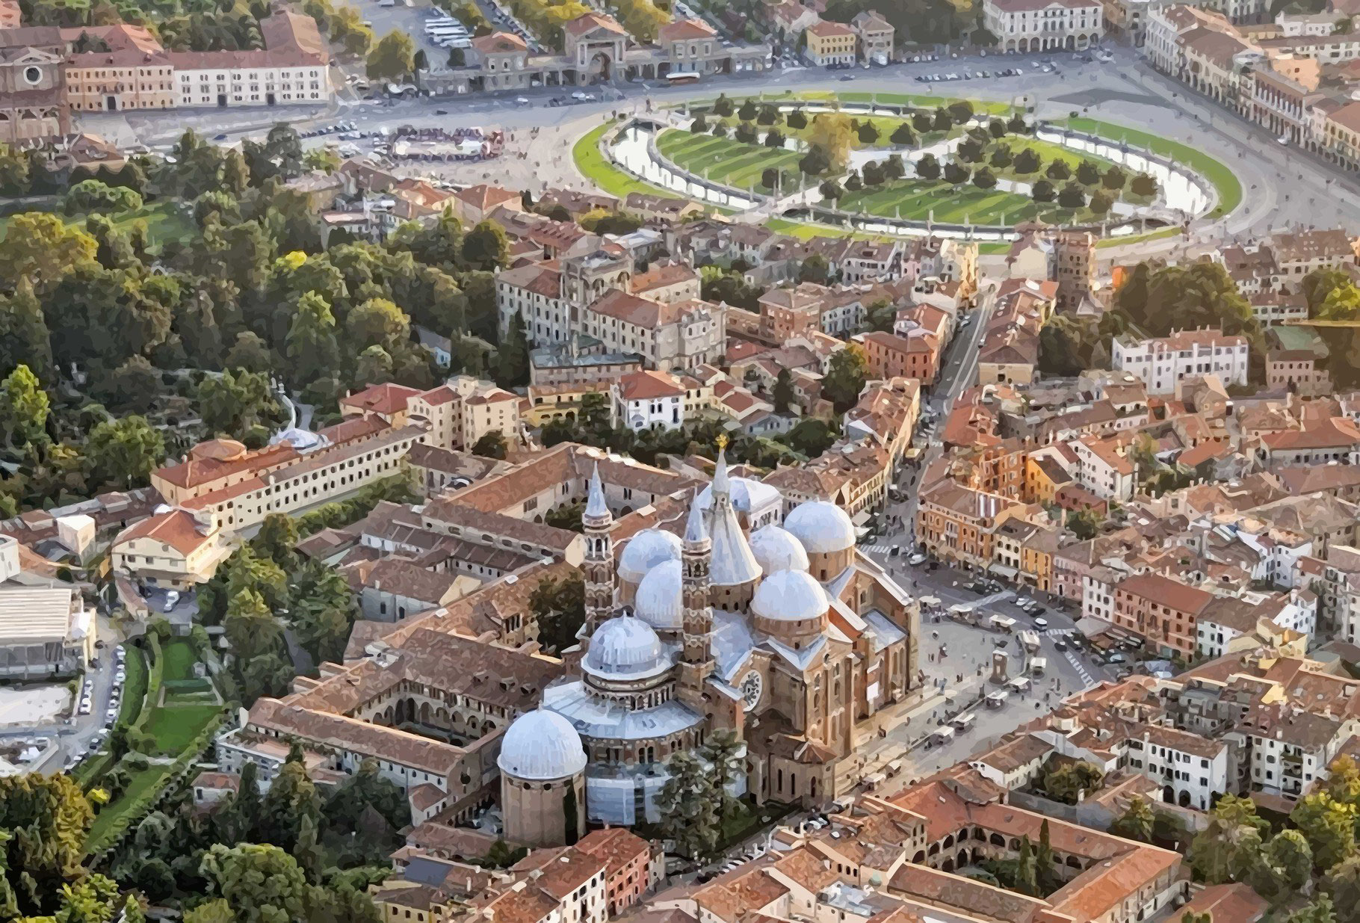
The city
AERIAL VIEW
Saint Anthony Cathedral

Slide 8
The city
PRATO DELLA VALLE SQUARE
Prato della Valle Square

Slide 9
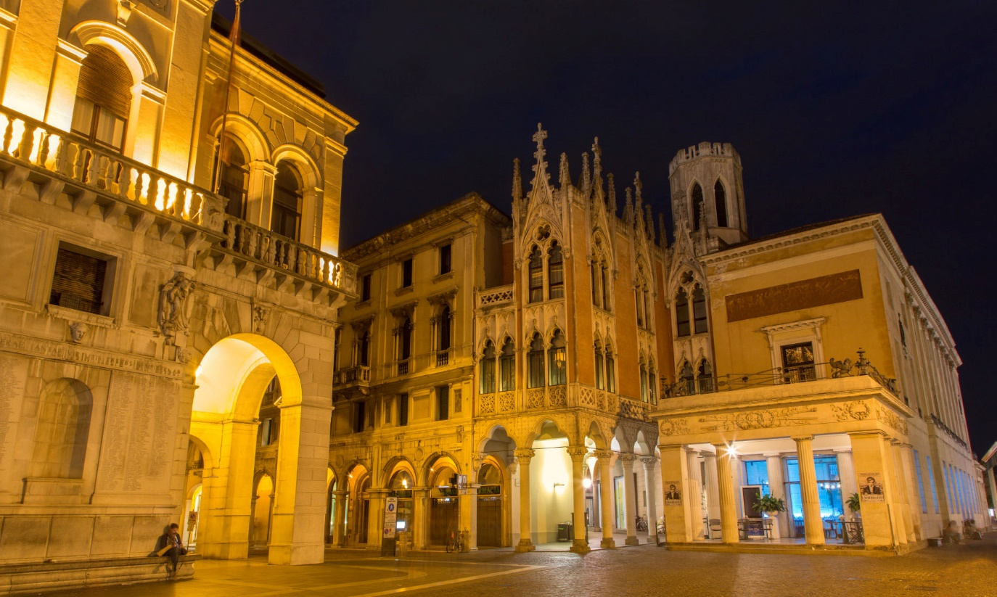
The city
CAFFE PEDROCCHI
Caffè Pedrocchi

Slide 10
The city
PALAZZO DELLA RAGIONE

Slide 11
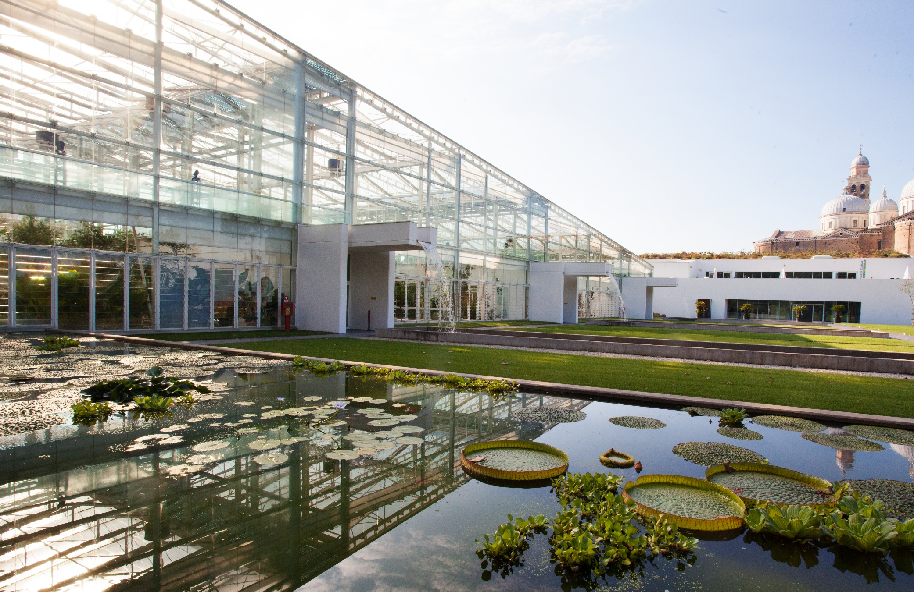
The city
BOTANICAL GARDEN

Slide 12
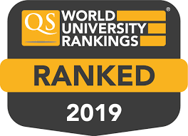
Why dSEA?
We rank among the best Economics and Management departments in Italy taking into account quality of teaching, students' placement, and research excellence
“Department of Excellence”, for the second time in a row
Globally, we are among the top 250 universities in “Business & Economics” according to the Times Higher Education and top 200 in “Social Sciences and Management” according to the QS World University Ranking

Slide 13
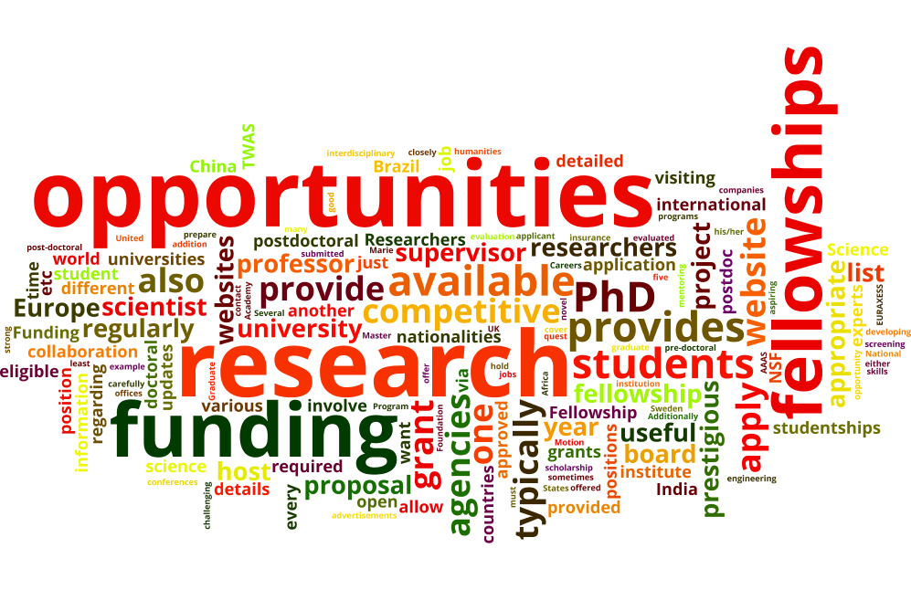
Why our PhD program?
4-years programme with several fully funded positions
PhD students are active members of a vibrant research community
Two curricula: Economics and Management
Both curricula sharing the same commitments, rules and main goal:
Training young researchers to achieve their full potential

Slide 14
Recent Placements
Our main goal is (also) confirmed by recent placements by former PhD Students taking up positions at Top Schools & Institutions worldwide:
Academia
University of Copenhagen
University of New South Wales
Max Planck Institute
Université de Lyon
University of Groningen
University of Warwick
European University Institute
University of Technology and Economics Budapest
University of Chicago
ESADE Business School
Universities of Bergamo, Bologna, Padova, Bicocca, Cattolica, Verona
Institutions & Private Sector:
World Bank, OECD
Moody’s, Intesa Bank, IBM

Slide 15
Overview
First year
Coursework – 3 terms October 2023 – May 2024
‘How To…’ short workshops
Summer research paper (May – September)
Select your PhD supervisory team

Slide 16
Overview
Next…
Research and dissertation development
Visiting period in a foreign university (min. 3 months)
Active Participation to departmental seminars (Economics and Management)
Teaching experience during the fourth year
Participation to conferences, workshops and summer schools

Slide 17
Supervisory Team & Visiting Period
Visiting Period
PhD candidates are strongly encouraged to spend at least one term as visiting fellow at a Top Research Institutions Worldwide
Financial Support (+50% of the scholarship)
Doctor Europeus
Supervision
Two supervisors
Choice of the Supervisory Team at the end of the coursework (year 1)

Slide 18
Overview
Requirements
First year
Pass all exams (min average grade: B). At most 1 retake
Positive evaluation of the summer paper
Second, Third, and fourth Year
Positive evaluation of research activities by the Board of the school (supervisor and co-supervisor too!)
Final Requirement
Admission to the doctoral defence

Slide 19
How to apply
The call for applications for 2023/24 will be published on Tuesday, 9 May 2023 here:
https://www.unipd.it/en/phd-programmes-calls-and-admissions
Application deadline: Wednesday, 7 June 2023
The application form must be submitted online. Do not send hard copy of the application by mail.
For more information on the selection procedure – as well as on our PhD programme - please send an email to: phd.economia@unipd.it

Slide 20
How to apply
In brief (but check the website on May 9!):
CV
a research proposal (max 5 pages)
degree certificates & transcripts
proof of English competence
two letters of recommendations
scientific publications (if any)
a short summary of the Master thesis (max 4 pages)
GRE general test is warmly recommended even if non mandatory.

Slide 21
Funding, Living & Support
The yearly scholarship is € 15,400 (approx. € 1100 per month)
PhD students have access to an office in the department and support for IT needs
Reasonable accommodation costs by ESU or private market: https://www.unipd.it/en/studying-padova/funding-and-fees/living-costs
Canteen is available during semesters
The Unipd PhD Office will help sorting the following:
Visas and Immigration
Healthcare and Primary Services
Housing and Living costs
More details here: https://www.unipd.it/en/arriving-living

Slide 22
Management Curriculum
Coursework
Research Areas
Faculty & Publications

Slide 23
Coursework
Management: First Year courses
MANAGEMENT 2023-24 | Strategy/Organization Track | Accounting/Finance Track | Single Track | Host
1 TERM (October – November 2023)
Econometrics for management | 50 |  | 50 | UniPD DSEA
Corporate governance | 30 |  | 30 | UniPD DSEA
Research Methods | 20 |  | 20 | UniPD DSEA
2 TERM (January – March 2024)
Organization theories | 20 |  | 20 | UniPD DSEA
Financial Accounting | 30 |  | 30 | UniPD DSEA
Strategic Management | 30 |  | 30 | UniPD DSEA
3 TERM, first year (select 3 courses) (April – May 2024)
Advanced Topics in Management | 20 | 20 | 20 | UniPD DSEA
Innovation Management | 20 |  | 20 | UniPD DSEA
Tools in Accounting and Finance | 20 | 20 | 20 | UniPD DSEA
Microeconometrics |  | 20 |  | UniPD DSEA
JOB MARKET ORIENTATION | third year students | third year students | 10 | Unipd DSEA

Slide 24
Management Curriculum: Research Areas
Accounting & Finance
Corporate Governance: Boardroom Dynamics & Processes
Economics of Criminal Firms
Financial Information & Regulation in the Banking Industry
Non-Financial Disclosure and Corporate Social Responsibility
Strategy, Innovation & Organizational Behavior
Cluster evolutions & Internationalization Processes
Entrepreneurship, New Ventures & SMEs
Environmental Sustainability & Social Innovation
Innovation, Technology transfer & Spin-Offs
Organization, Jobs, Corporate Resilience
Operational Excellence: Supply Chain & Organizational Routines

Slide 25
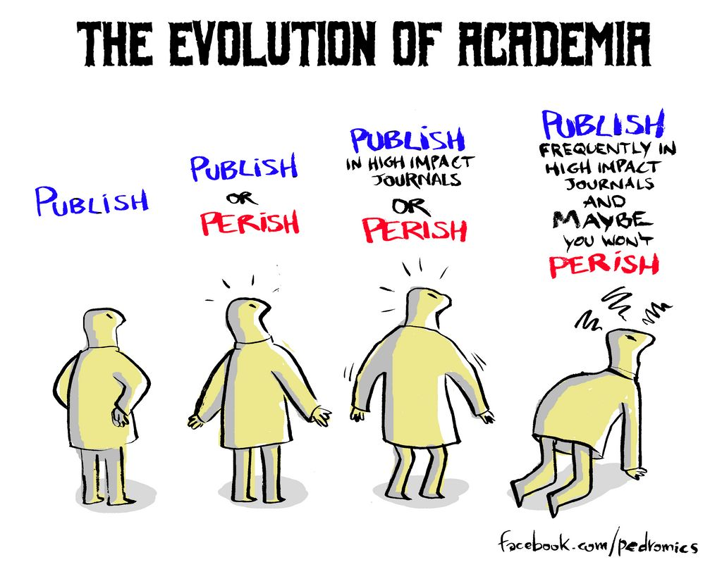
Management Curriculum:
Faculty & Publications
Top-Tier Publications:
Journal of Accounting Research
Academy of Management Journal
British Journal of Management
Corporate Governance: an International Review
European Accounting Review
European Journal of Finance
Family Business Review
Journal of Business Research
Organization Science
Research Policy
Review of Accounting Studies
Strategic Management Journal
FT50
Journals
CABS
4 and 4*
Journals
VQR
Italian Journal Ranking

Slide 26
Economics Curriculum
Coursework
Research Areas
Faculty & Publications

Slide 27
Coursework

Slide 28
Economics Curriculum: Research Areas
Applied Economics: identify and measure causal effects in many domains
ageing, health, consumer behaviour
policy evaluation
labour and education economics
applied political economy

Slide 29
Economics Curriculum: Research Areas
Political Economy, Matching Theory, Experimental Economics
Trade and International Trade, Economic History
Regional and Urban Economics
Macroeconomics, Monetary Economics

Slide 30
Economics Curriculum: Research Areas
Industrial Organization, Energy and Environmental Economics
Healthcare Economics
Auctions Theory and Experiment, Procurements, Public Economics
Banking and Financial Markets

Slide 31
Economics Curriculum:
Faculty & Publications
Top-Tier Publications:
American Economic Review
Review of Economic Studies
Journal of the European Economic Association
Journal of Labour Economics
Journal of Development Economics
The Economic Journal
Journal of Public Economics
Journal of International Economics
Journal of Economic Theory
Journal of Health Economics
Theoretical Economics
European Economic Review
Games and Economic behavior
American Journal of Political Science
…and many others.
VQR
Italian Journal Ranking

Slide 32
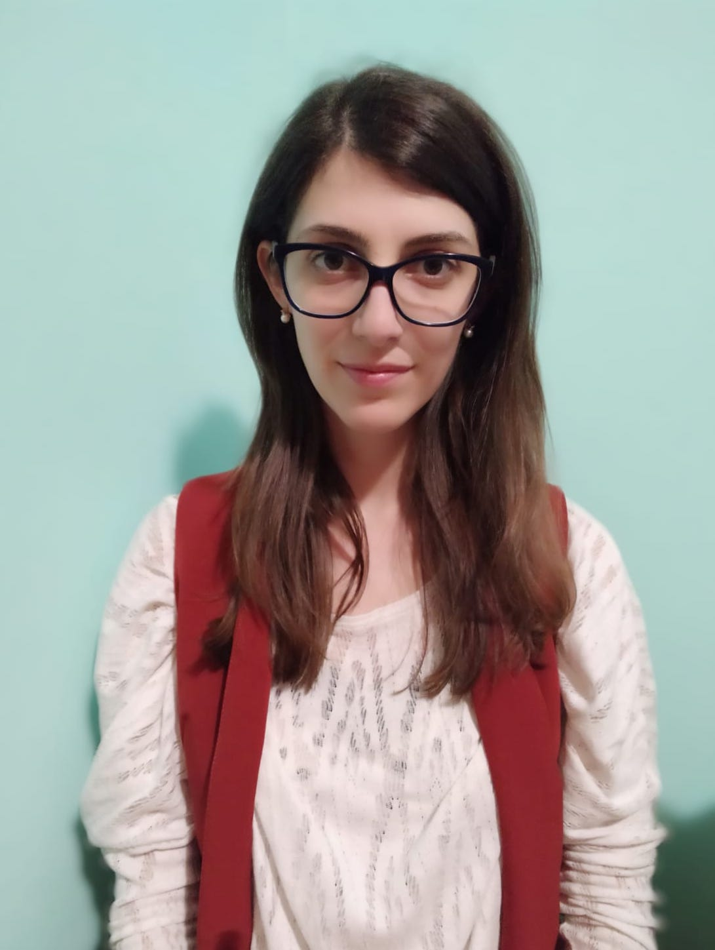
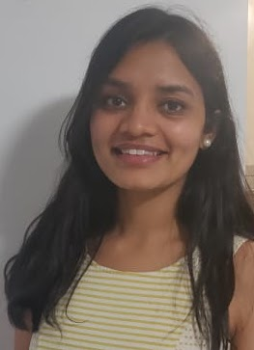
Alumnae Stories
Michela Carraro
Isha Gupta

Slide 33
Q&A

Slide 34
Thank you for attending!
Looking forward to receiving your application!
Deadline: June 7th , 2023

Slide 35
@Dipartimento di Scienze Economiche
e Aziendali - Università di Padova
@dsea.padova
@dsea_unipd
@dsea_unipd
@dsea unipd
www.economia.unipd.it

