Slide 1
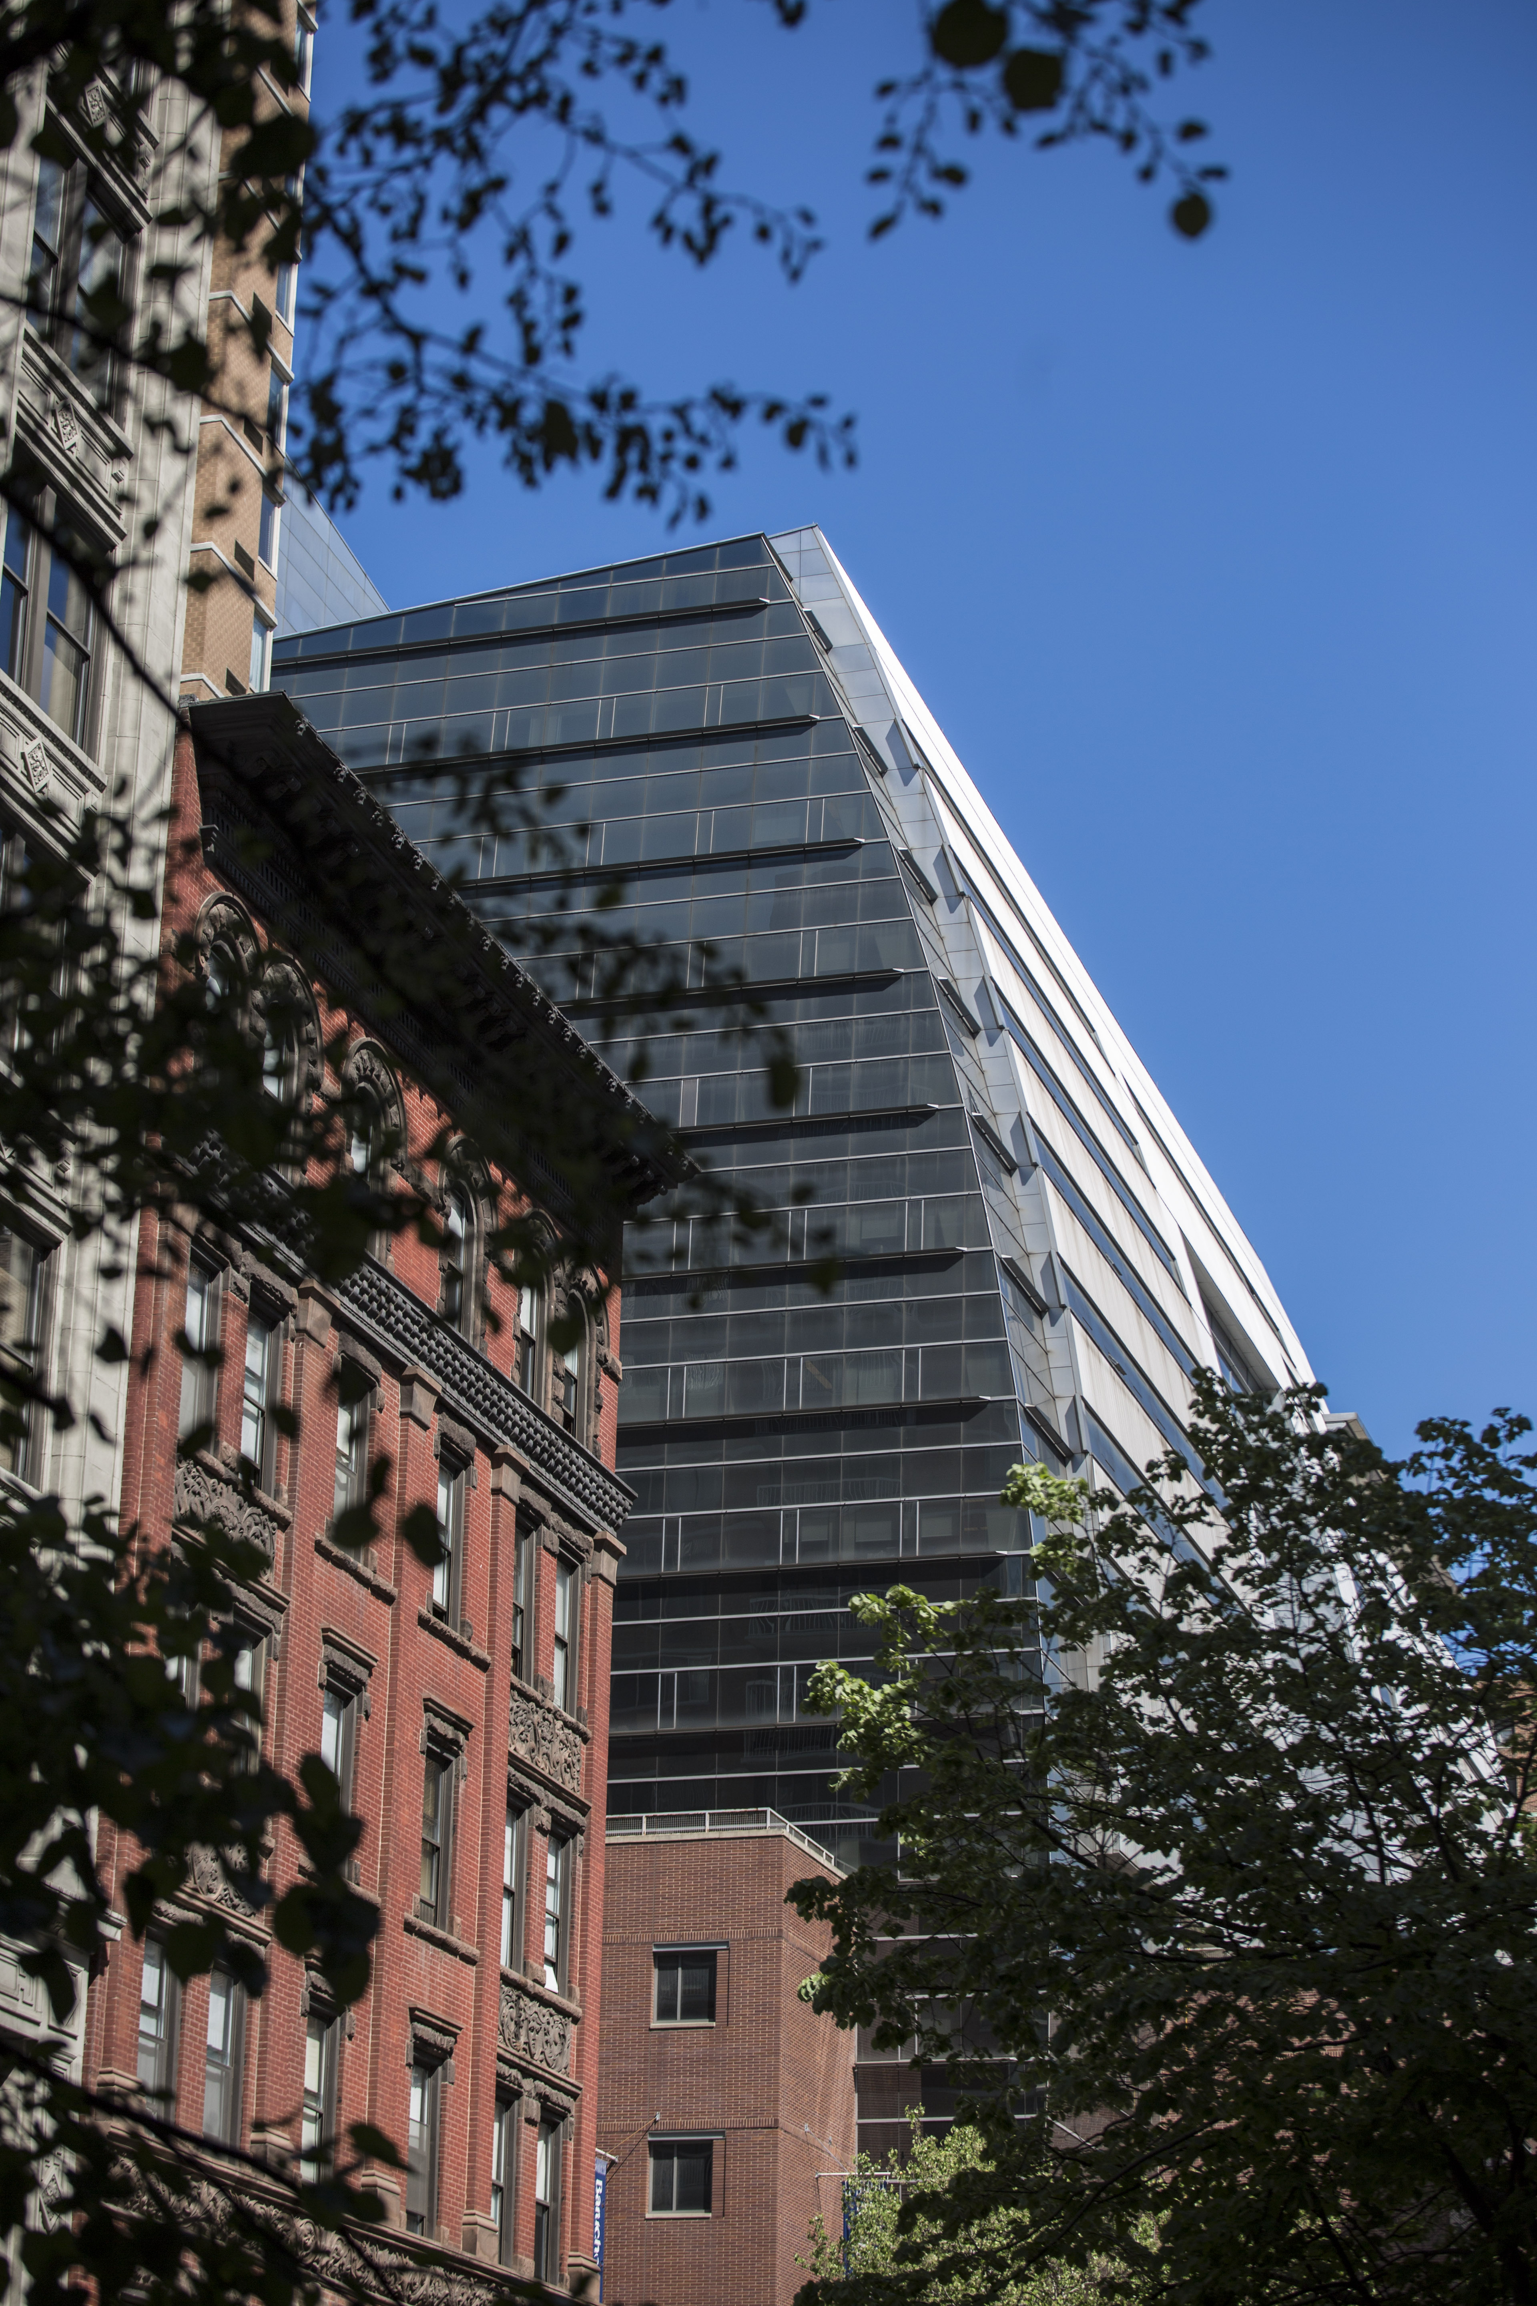
Global MS Finance Dual Degree Graduate Program

Slide 2
You’ll Be Part of a Leading Urban University…
City University of New York
25 colleges across New York City
275,000 students
Baruch College
Nearly 20,000 students
155 countries represented on campus with more than 100 languages spoken

Slide 3
… with a home at Zicklin
Zicklin School of Business
Founded as a Business School in 1919
Largest AACSB accredited residential school in the U.S.
120,000+ Zicklin alumni
28% International
2,700+ Graduate students
Academic Advisor dedicated to the GDD Program and your success!
Ms. Rong (Aloe) Yan

Slide 4
Why Baruch? Why Zicklin?
Excellence and Access
Baruch is the #1 in the 2024 Social Mobility Index
CollegeNET
Baruch is the #1 Top U.S. Colleges Offering the Best Value
The Wall Street Journal/College Pulse
Baruch is the #1 public college (#3 overall) with the greatest economic diversity.
College-Access Index published by The New York Times (2023).
Baruch Ranks in the top 25 for Best Value Colleges and top 20 Best Alumni Networks (Public Schools)
The Princeton Review.
Ranks in the top 25 Best Public Colleges in the U.S.
The Wall Street Journal.
Zicklin is #52 Best Business School in the U.S.
Bloomberg/Businessweek

Slide 5
Why MS Finance? Why Dual Degree Program?
World-class faculty
Full time faculty
More than 40: https://zicklin.baruch.cuny.edu/faculty-research/academic-departments/economics-finance/faculty/
Part time faculty
Many Wall Street Professionals
STEM designated program
Up to 3 years of Optional Practical Training (OPT)
Global perspective
Prestigious partner schools from Europe and Asia

Slide 6
Program Cost
Tuition and Fees: $20,521
Good-faith estimate, varies depending on credits transferred, schedule, etc.
1.2 x in-state tuition; much lower than out-of-state tuition rate
Student Living Expenses (estimated by ISSC):
Books and Supplies $1,500
Transportation $1,584
Personal Expenses $3,690
Meals $5,776
Housing $23,904
Total $36,454

Slide 7
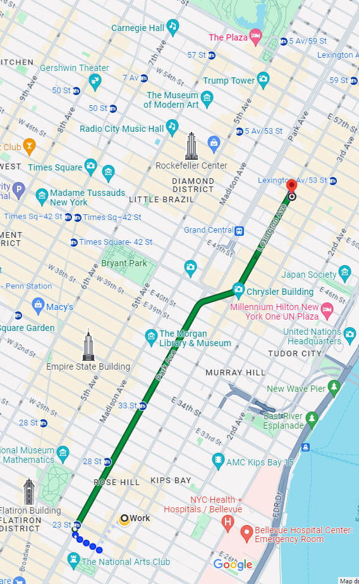
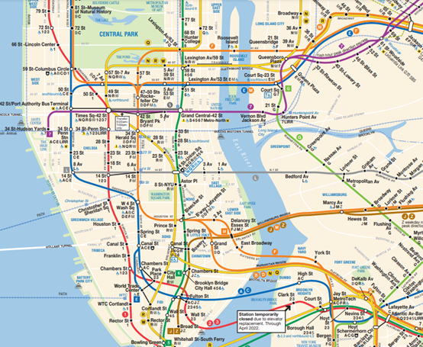
Housing
College housing:
https://studentaffairs.baruch.cuny.edu/residence-life/
Off campus:
https://streeteasy.com/

Slide 8
MS Finance Program Elements
Typical Admission Criteria: GPA above 3.0 and interview
Language of Instruction: English
Total # of Credits: 30
Transfer Credits: Maximum of 6
Credits in Partner Location/Online: 6, in July/August
Length of Study and # of Credits in NYC: 9-12 months with 18-24 credits

Slide 9
Sample MS Finance Schedule
Classes may be valued at 3 credits or 1.5 credits, so the number of classes will vary.
This sample schedule is for a scenario for a student transferring in 3 credits.
Fintech track is newly added.

Slide 10
Elective Example FIN9790: Essential Lessons from the US Financial Crisis
Explains the essential business, finance, management and career lessons that people should take away from the 2008 US Financial Crisis
Discusses similarities and differences with past crises, and the effect on markets and the economy of the COVID-19 crisis
Addresses macroeconomic, structural, capital markets, public policy, corporate governance and risk management issues
Reviews case studies of firms at the center of the Crisis
Ron Mandle, MBA from MIT
highly ranked sell-side bank stock analyst for 30+ years
13 years as a partner at Sanford C. Bernstein & Co.
10 years as an analyst/portfolio manager at GIC, the Singapore sovereign wealth fund, involved in GIC’s large (and profitable) investment in Citigroup

Slide 11
Experiences
Grad Student Organizations Zicklin Women in Business Zicklin Investment Club Data science and Analytics Society Zicklin Finance Club | Centers & Institutes Subotnick Center/Wasserman Trading Floor Lawrence N. Field Center for Entrepreneurship Weissman Center For International Business The Steven L. Newman Real Estate Institute

Slide 12
Zicklin’s Graduate Career Management Center (GCMC) offers you:

Slide 13
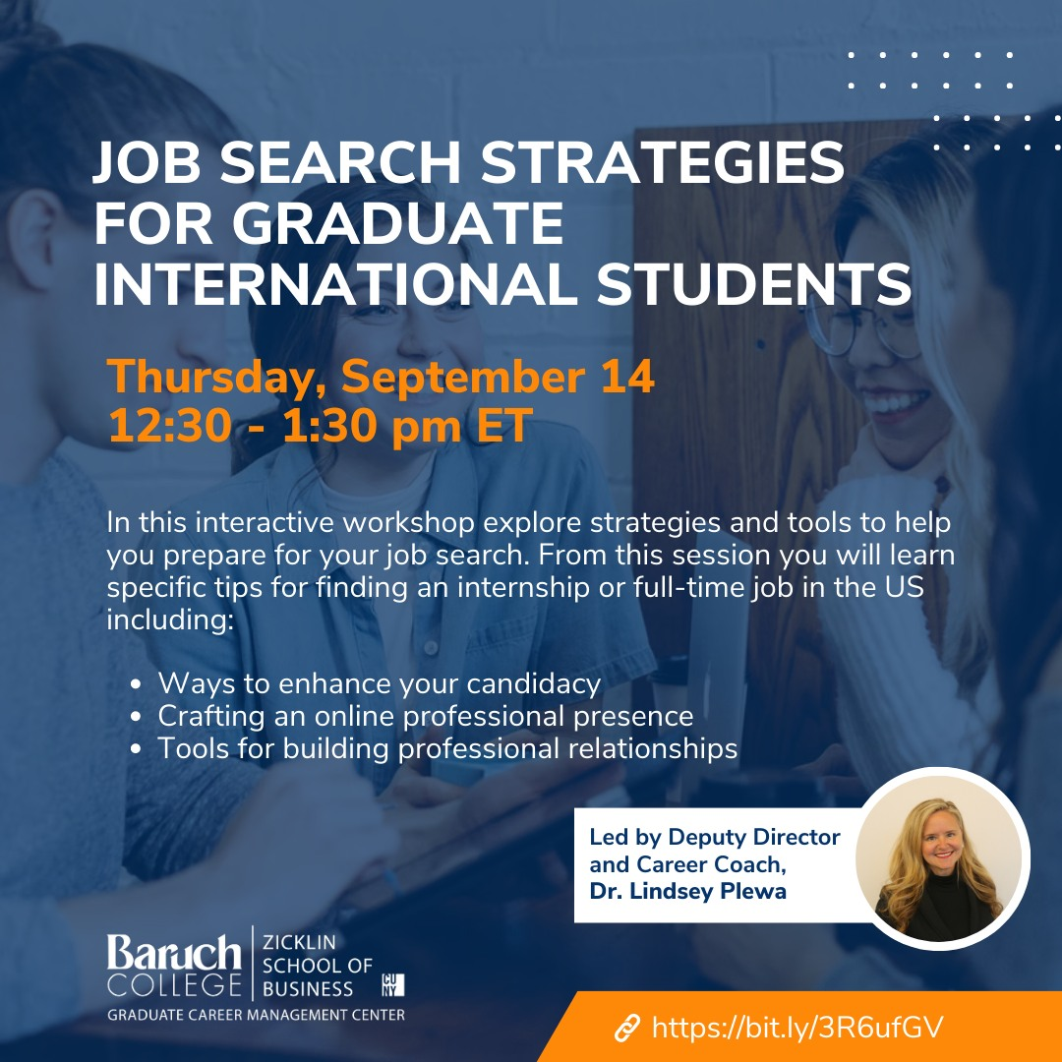
Sample of Recent GCMC Events

Slide 14
Firms Employing 2022-23 MS Finance Graduates
Accenture
American Express
Citi
Deloitte
J.P. Morgan
Morgan Stanley
New York Life Insurance Company

Slide 15
Admissions Timeline
March-April
Interview
May-June
Submit Zicklin online application by May 1
July
August
Obtain your F-1 visa by mid-August
Summer courses
Admission letter sent out between May and June

Slide 16
MS Finance Program Highlights Recap
Excellent location
In the heart of Manhattan, New York City
A stone’s throw away from Wall Street
Long OPT
STEM designated program
Up to three years of OPT
Remarkable ROI
1.2 x In-state tuition rate
Prestigious partner schools
First cohort from Peking University in 2017
10 partner schools in Asia and Europe

Slide 17
We hope to welcome you to New York!

Slide 18
Thank You!
Email: ZicklinGlobal@baruch.cuny.edu
Phone: +1 646.312.3075
Websites:
Global Zicklin
MS Finance Curriculum

